Slide 1

9238-Mangayarkarasi college of Engineering (Approved by AICTE, New Delhi & Affiliated to Anna University, Chennai ) MANGAYARKARASI NAGAR,PARAVAI,MADURAI-625 402 Website: http://mce-madurai.ac.in E-Mail: mangai.enggcoll@gmail.com
Phase-2 innovation
Iot-noise pollution monitoring
Project Team Members
Aarthi Murugan (923821106001)
N.Aruna Shree(923821106007)
K.saranya(923821106045)
A.sujitha Jasmine(923821106051)
S.shabira(923821106049)
R.priyadharshini(923821106037)
Project guide,
Mr.r.m.senthil kumar,ap/ece

Slide 2

Abstract
In this implementation phase of our noise Pollution Monitoring project, we focus on deploying sensors strategically to collect critical environmental data. We carefully choose sensor locations based on High noisy areas, ensuring comprehensive coverage. Our IoT device, equipped with sensors, continuously monitors conditions .00This phase involves hardware selection, device programming, and cloud integration, enabling us to transform our project from concept to reality. Our ultimate goal is to monitoring the noise Pollution Through this innovative solution, we bridge the gap between technology and nature, fostering environmental awareness .

Slide 3

Introduction
In this phase, we will translate our project vision into a tangible reality by setting up IoT devices strategically placed throughout the crouds to monitor crucial environmental conditions, primarily focusing on sound. The collected data will be seamlessly transmitted to the cloud via ESP8266 modules, where it will be processed and made available to the public through a user-friendly platform. As we proceed, we will outline the steps and methodologies that will guide us through the implementation process. From selecting the right hardware components to programming and configuring the IoT device, we will provide insights into how we plan to transform our project from concept to reality.

Slide 4
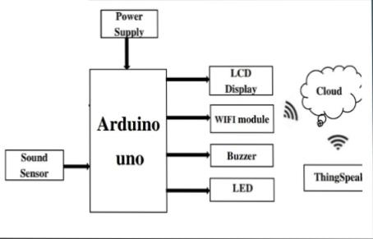
Block diagram

Slide 5
Components required
ArduinoUNO LM393 (Noisesensor) ESP8266 WIFIModule 16*2 LCDDisplay LED
Buzzer

Slide 6
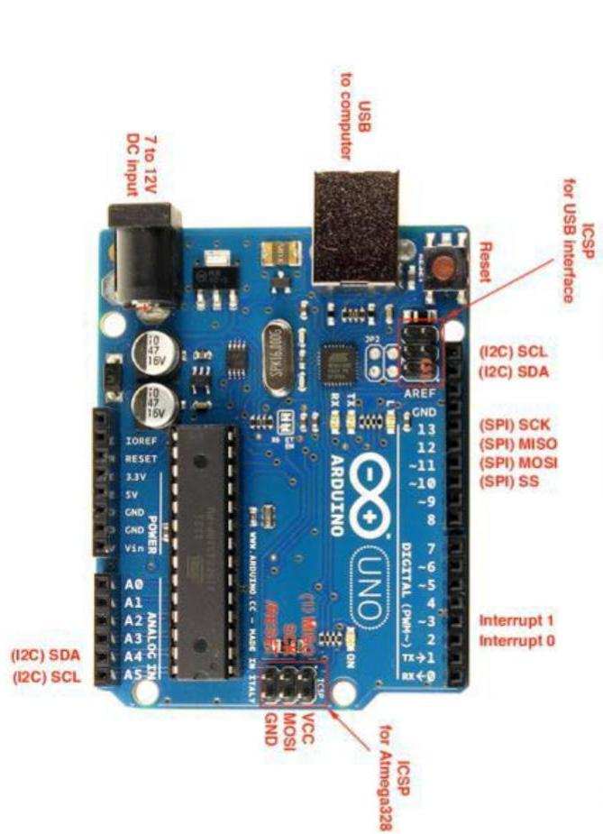
Arduino UNO
Arduino Uno provides a convenient platform for interfacing with various sensors, including temperature and humidity sensors. It has analog and digital pins that can read sensor data, making it easy to integrate sensors into your project. Arduino Uno serves as the brain of your IoT device. It can run the necessary code to read sensor data, process it, and send it to the cloud using the ESP8266 module. Its processing power is well-suited for the task, and it has a large user community with extensive resources for programming. Arduino is open-source, which means you have the freedom to modify and customize both the hardware and software to suit your project’s specific needs. Arduino Uno is an affordable microcontroller board, making it a cost-effective choice for your project.

Slide 7
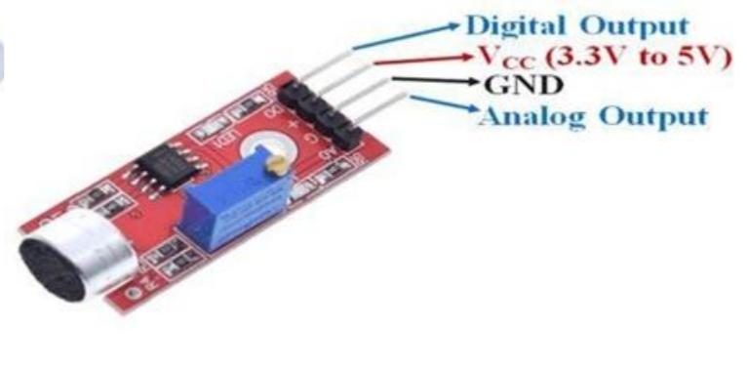
Lm393 noise Sensor
The sound sensor module provide an easy way to detect sound and it generally used for detecting sound intensity. Module detect the sound has exceeded a threshold value. Sound is detected via microphone and fed into an LM393 op amp. The sound level adjust through pot. The sound increases set value output is low. These module work on DC 3.3-5 voltage.

Slide 8
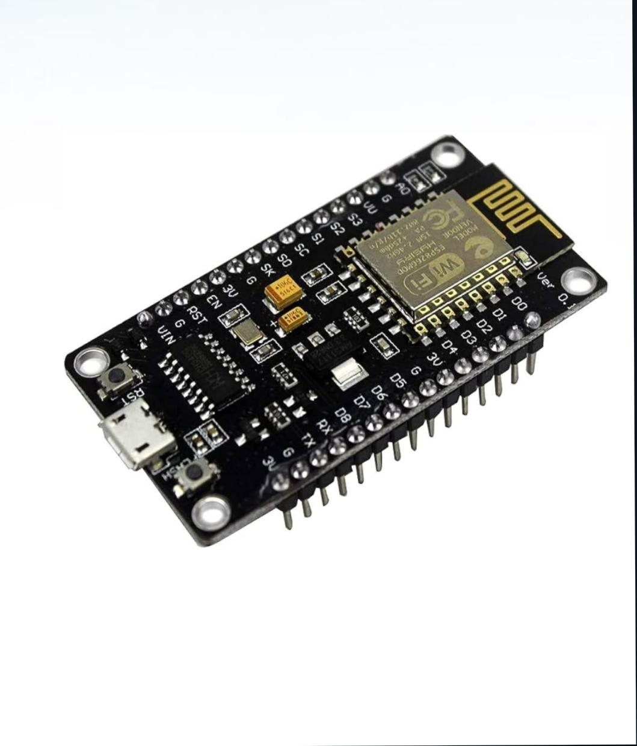
Esp8266 wifi-module
The ESP8266 provides built-in Wi-Fi connectivity, enabling your IoT devices to communicate with the cloud and transmit environmental data without the need for additional external Wi-Fi modules. This is essential for real-time data transmission to a central database. The ESP8266 module is well-documented and widely supported in the maker and IoT communities. It’s relatively easy to integrate into your hardware setup and program to communicate with the cloud platform. With the ESP8266, you can remotely monitor and manage your IoT devices in the park. This allows you to update device firmware, troubleshoot issues, and ensure the system operates smoothly without physically visiting each sensor location. Many ESP8266 modules are designed to operate efficiently. This is important in projects where power supply options may be limited, such as battery-powered sensors.

Slide 9
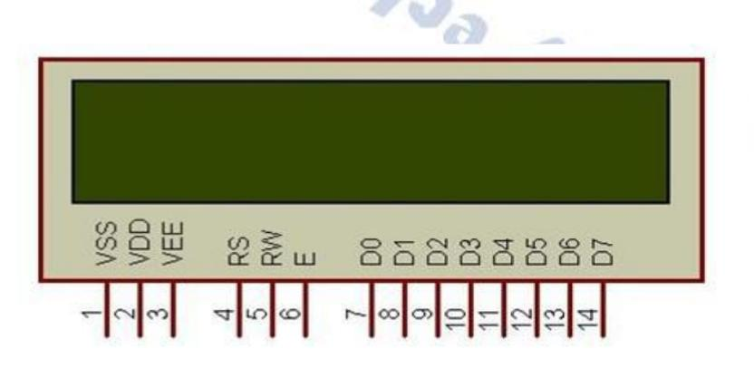
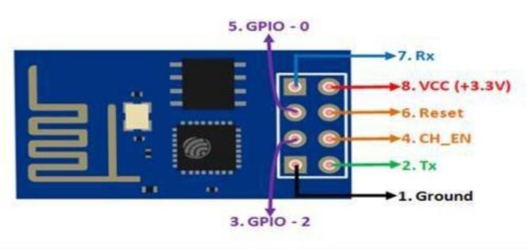
Visualization
LCD is used for to display the condition there are three conditions in noise pollution means sound is clear, moderately polluted or highly polluted that is displayed on LED.

Slide 10

Process
Algorithm:
1. Start Arduino UNO.
2. initialize LCD, gas sensor & noise sensor
3. Establish WITI connections.
4. If connection successful. Next step else go to step 1
5. Read sensor values.
6. If Sensor value available establish TCP connection else read values again.
7. Establish TCP connection
8. If TCP connections successful. Send data to server (Thing speak). Else set go to step 7
. 9. Check for acknowledgement.
10.If acknowledgement received. Go to step some time & else wait for go to step no 5.

Slide 11
Process explanation
1.noise sensors, are strategically placed in specific areas. These sensors continuously collect data from their surroundings.
2.The sensors capture real-time environmental data of noise levels. Each sensor is connected to an IoT (Internet of Things) device.
. 3. The IoT device, often equipped with microcontrollers (e.g., Arduino or Raspberry Pi) and the ESP8266 module for Wi-Fi connectivity, acts as the data aggregator. It reads data from the sensors.
4.The IoT device processes the collected data, converting sensor readings into usable digital information.
5.Using the built-in Wi-Fi capability of the ESP8266 module, the IoT device sends the processed data to a cloud-based platform. This cloud platform can be hosted on services like AWS, Azure, or specialized IoT platforms.
6.The cloud platform stores the environmental data securely and makes it accessible for analysis and visualization.
7.This interface fetches data from the cloud platform and displays real-time environmental information using charts, graphs, or other visualizations.
8.The system can be configured to send alerts or notifications ,if specific environmental conditions, such as high noise levels, are detected.

Slide 12
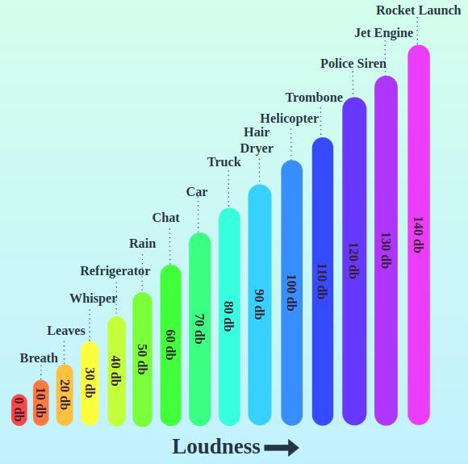
Noise Pollution patterns

Slide 13
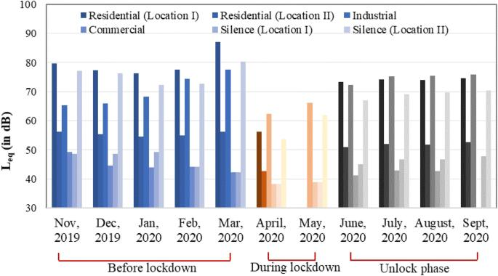
High noise areas
Noise Pollution monitoring during lockdown in residential areas and factories

Slide 14
Potential sources of noise
Sources of noise pollution:
Noise pollution can come from outdoor sources, such as road traffic, jet planes, garbage trucks, construction equipment, manufacturing process- es, lawn mowers, leaf blowers, and indoor sources, including: boom boxes, heating and air conditioning units, and metal chairs scraping on floors.
Way to reduce noise pollution : We can Reduce Noise pollution by turning off appliances when not in use, use of earplugs, lowering the volume, planting more trees, regular maintenance of vehicles and machines etc. By controlling noise we can control negative health effects that noise pollution has on everyone.
Sources of noise pollution in industries :
The three most damaging sources of noise pollution in an industrial setting are machinery, construction, and vehicles. People who work with drills, punch presses, saws, mills, lathes, and progressive dies must wear protective equipment to avoid the adverse effects of noise pollution.

Slide 15

Conclusion
As we move forward, we aim to continue improving and expanding this system to make a positive impact on both the environment and people’s lives. We thank you for your attention and look forward to collaborating for a more informed future.

